Slide 1

Chinese Modern Wedding Custom
---- The Wedding Banquet
A. It Is the Most Important Part in Chinese Modern Wedding Custom
B. The Dominate Color Of Wedding Feast is Red
C. The Procedure Of The Wedding Banquet
D. The Newlyweds’ Dressing

Slide 2
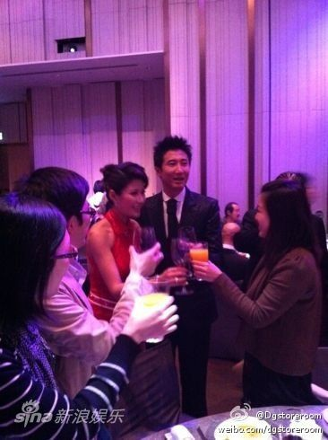
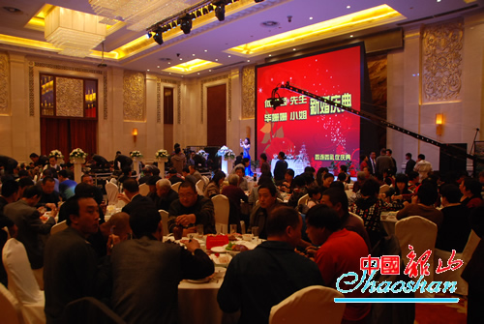
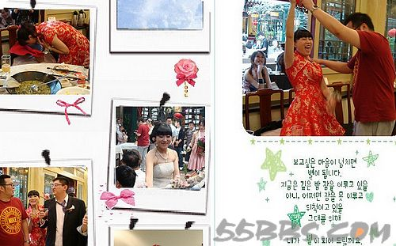
A. It Is the Most Important Part
in Chinese Modern Wedding Custom
Modern Chinese
Wedding banquet

Slide 3
A. It Is the Most Important Part
in Chinese Modern Wedding Custom
liǎn
Face 脸

Slide 4
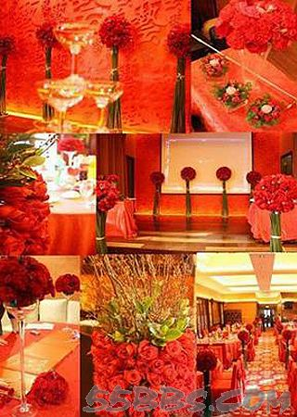
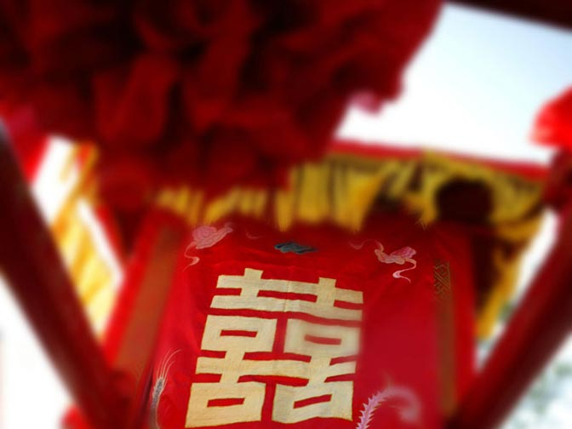
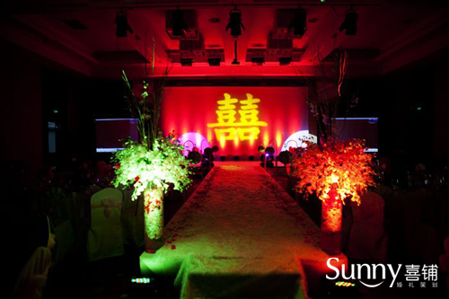
B. The Dominate Color
Of Wedding Feast is Red

Slide 5
B. The Dominate Color
Of Wedding Feast is Red
nián
Year 年

Slide 6

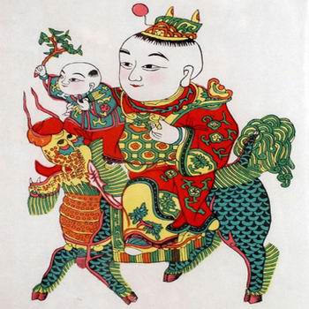
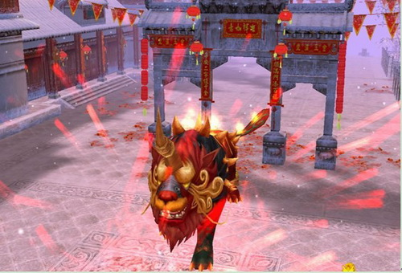
B. The Dominate Color
Of Wedding Feast is Red
The Origin Of “Year”

Slide 7
B. The Dominate Color
Of Wedding Feast is Red

Slide 8
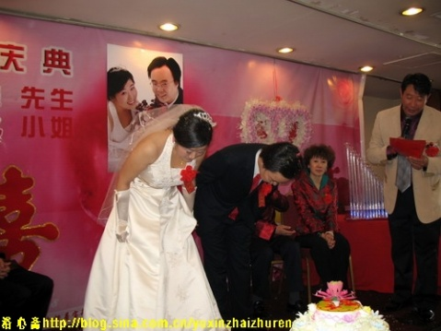
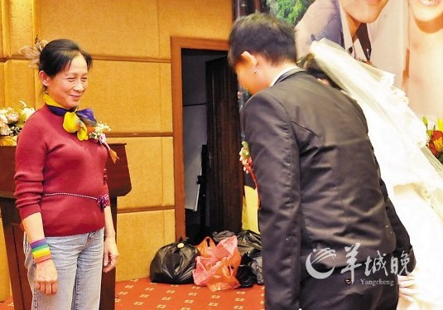
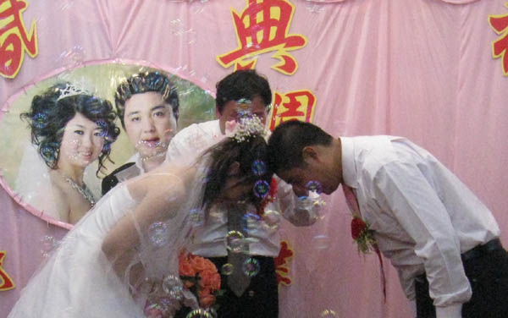
C. The Procedure Of
The Wedding Banquet
Chinese wedding tea ceremony

Slide 9
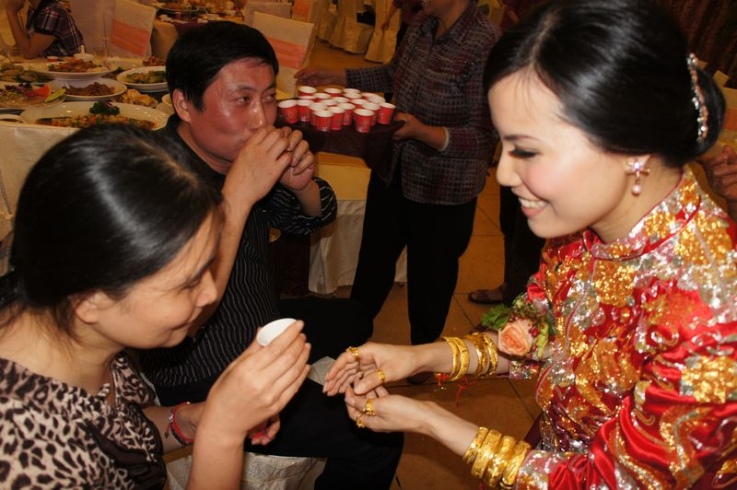
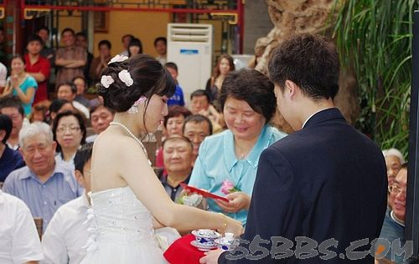
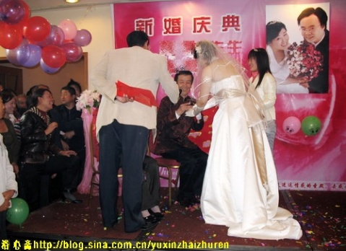
C. The Procedure Of
The Wedding Banquet
Chinese wedding tea ceremony

Slide 10
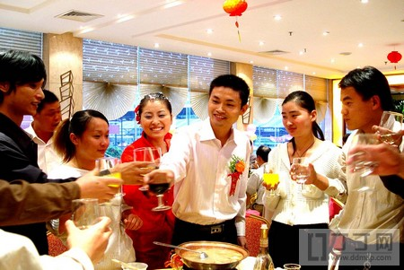
C. The Procedure Of
The Wedding Banquet
Wedding Banquet--Toasting

Slide 11
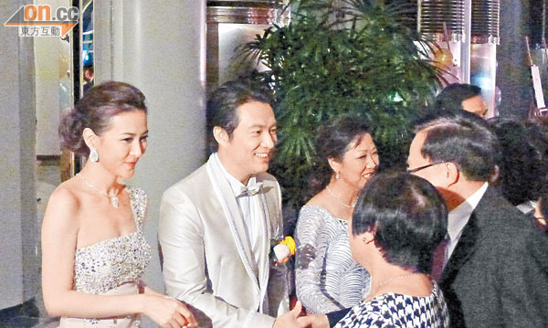
C. The Procedure Of
The Wedding Banquet
After Banquet—Thanking Guests

Slide 12
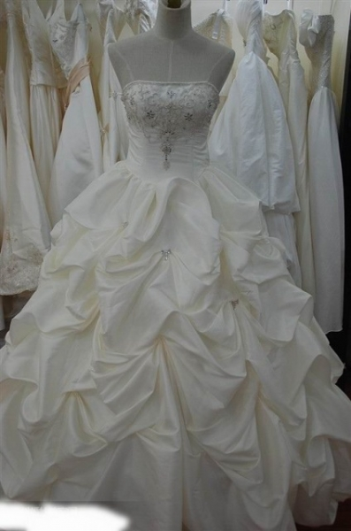
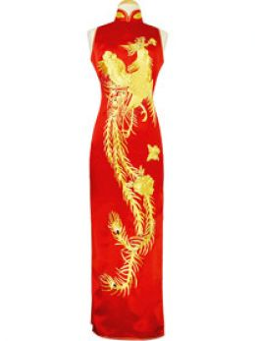
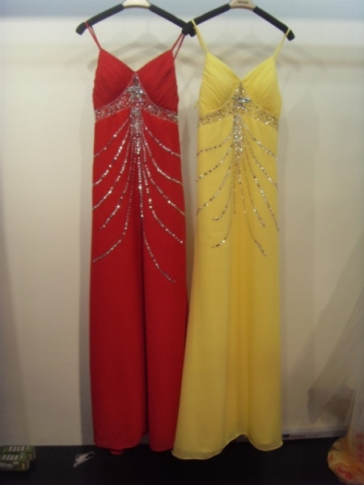
D. The Newlyweds’ Dressing
Brides’ Wedding Dresses

Slide 13
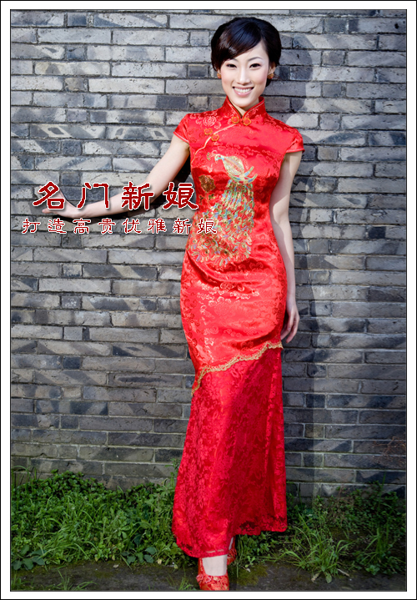
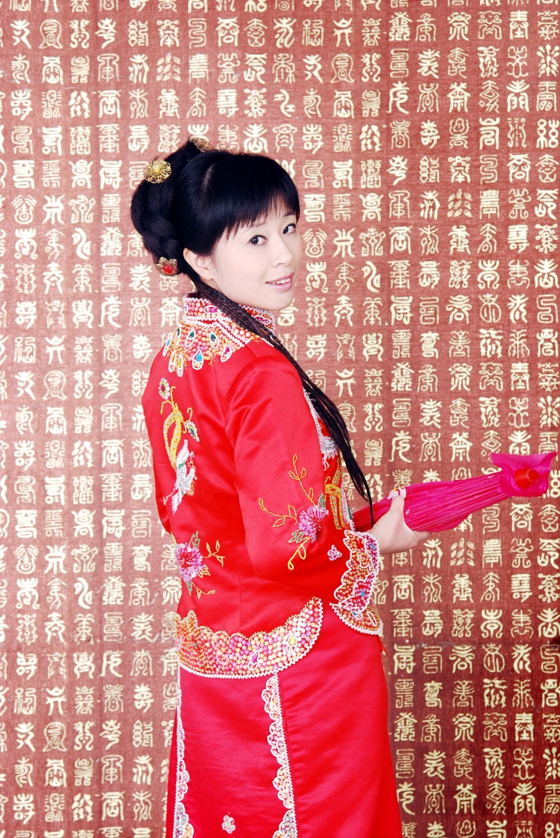
D. The Newlyweds’ Dressing
Qi Pao
Qun Gua

